Slide 1
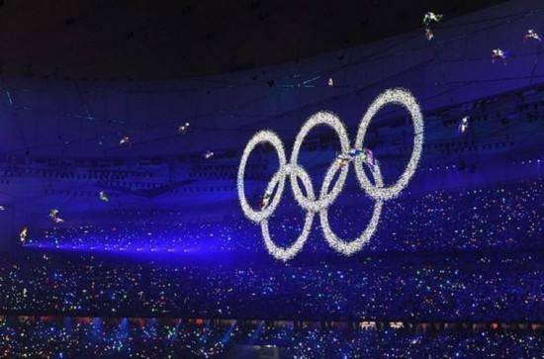


Slide 2


Slide 3



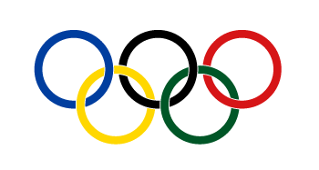

What do the five rings on the Olympic flag stand for?
The five rings stand for friendship of five continents.
Blue =
Europe
Africa
Red =
America
Black =
Asia
Green =
Oceania
Yellow =

Slide 4

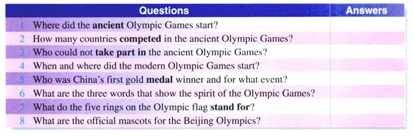
Do the following quiz as quickly as possible and we will see who does the best.

Slide 5


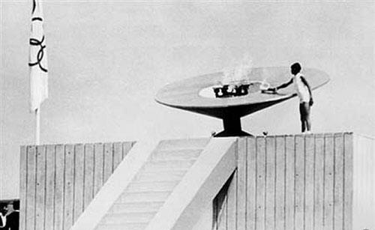
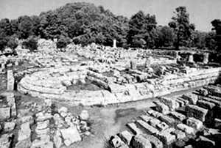

Quiz
1. Where did the ancient Olympic Games start?
Olympia (Greece).

Slide 6
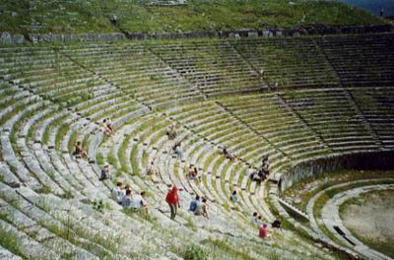
2. How many countries competed in the ancient Olympic Games?
One (Greece).

Slide 7
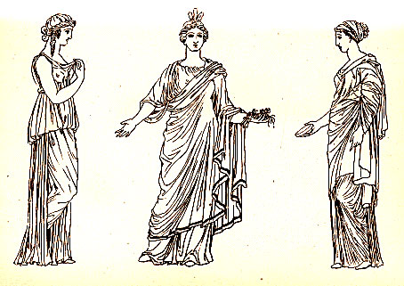
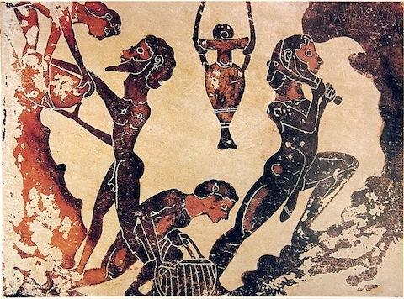
3. Who could not take part in the ancient Olympic Games?
Slaves and women.

Slide 8
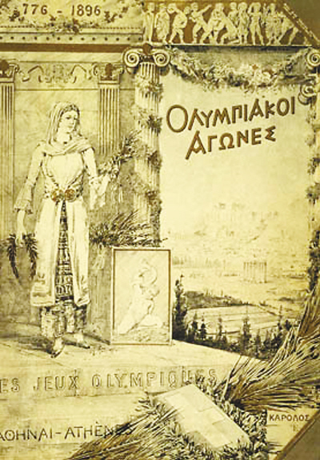
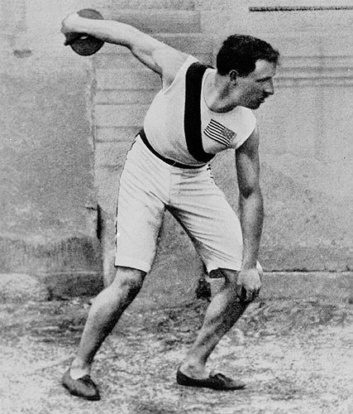
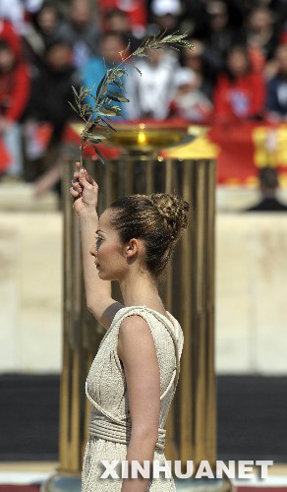
4. When and where did the modern Olympic Games start?
Athens in 1896.

Slide 9
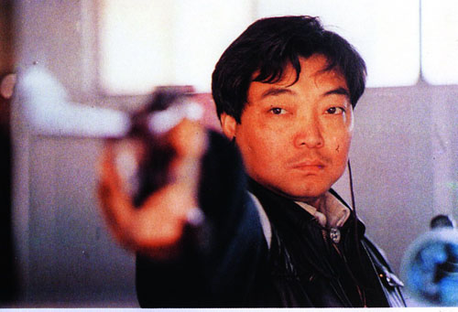
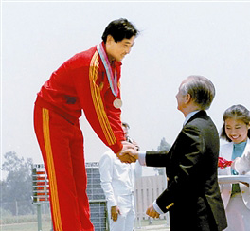
5. Who was China’s first gold medal winner and for what event?
Xu Haifeng for shooting.

Slide 10
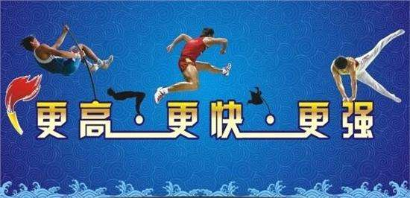
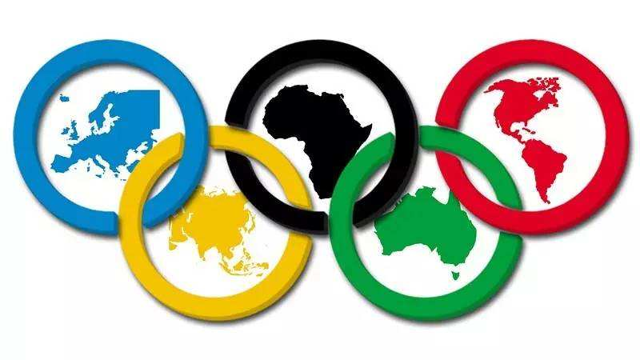
6. What are the three words that show the spirit of Olympic Games?
Swifter, Higher, Stronger.
7. What do the five rings on the Olympic flag stand for?
The five continents.

Slide 11
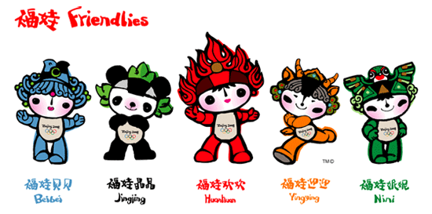
8. What are the official mascots for the Beijing Olympics?
The five mascots are officially called the Five Fuwas. They are Beibei, the fish; Jingjing, the panda; Huanhuan, the Olympic flame;

Slide 12
Yingying, the Tibetan antelope; and Nini, the swallow.

Slide 13

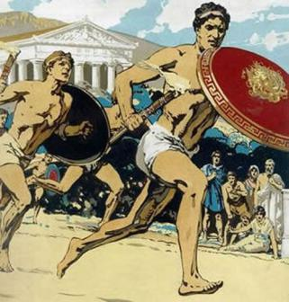
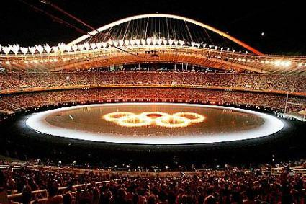
What are the differences between
the ancient and modern Olympic
Games?
VS
The Ancient
Olympic Games
The Modern
Olympic Games

Slide 14

1. Scan the passage and find the characteristics/differences and similarities between the ancient Olympic games and the modern Olympic games.

Slide 15
Differences
 | Ancient Olympics | Modern Olympics
Types
Events
Athletes
only one set
two main sets of Games
fewer
more than 250 events
No women or slaves could take part.
Anyone can take
part if they reach the standard.

Slide 16
 | Ancient Olympics | Modern Olympics
Where the athletes come from
Prize
only from Greece
from all over the world
an olive
wreath
medals

Slide 17
Similarities
having running races
held every four years
no prize money for winners
4. the same motto

Slide 18
2. Discuss with your partners “why
do so many countries want to host
the Olympic Games while other do
not?”

Slide 19
great
responsibility
a great
honour
Reasons to
host the OG
new
investment
tourism
national
pride
new sports
facilities

Slide 20
too
expensive
much
planning
Reasons
not to host
the OG
pressure+
stress
accidents
/attacks
accom-
modation
Many
stadiums

Slide 21
3. Role-play. In pairs, act the parts
of Pausanias and Li Yan talking
about the differences between
ancient modern Olympics.

Slide 22


